Slide 1
Evidence for Living Species

Slide 2
By the end of this lesson, you should be able to:
• | Describe how comparative anatomy provides evidence for evolution.
• | Describe how comparative embryology provides evidence for evolution.
• | Describe how DNA comparisons provide evidence for evolution.

Slide 3
Evidence for evolution that comes from living species includes:
• | Comparative anatomy: | Looking at the similarities and differences of the body parts of organisms.
• | Comparative embryology: | Looking at the similarities and differences of the embryo (unborn organism) during the course of its development before birth.
• | Chemical comparisons: | Looking at the similarities and differences in genetic make-up.

Slide 4
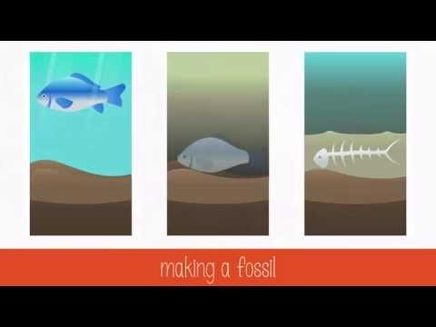

Slide 5
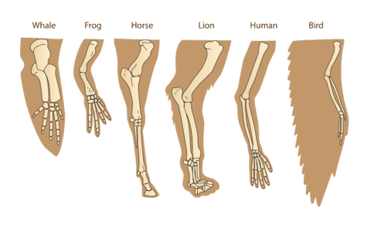
Anatomical and developmental similarities between different living species can provide evidence for evolution.
These similarities are investigated via comparative anatomy and comparative embryology.

Slide 6


Slide 7
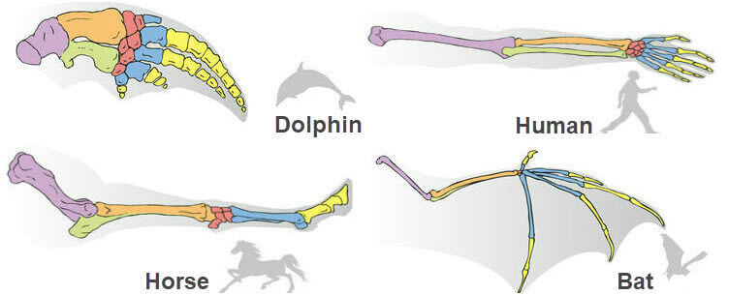
For example, the matching colours in the image below show that these species' limbs have a similar structure, even though they have different functions.
The similarity of these limbs provide evidence that they share a common ancestor.

Slide 8
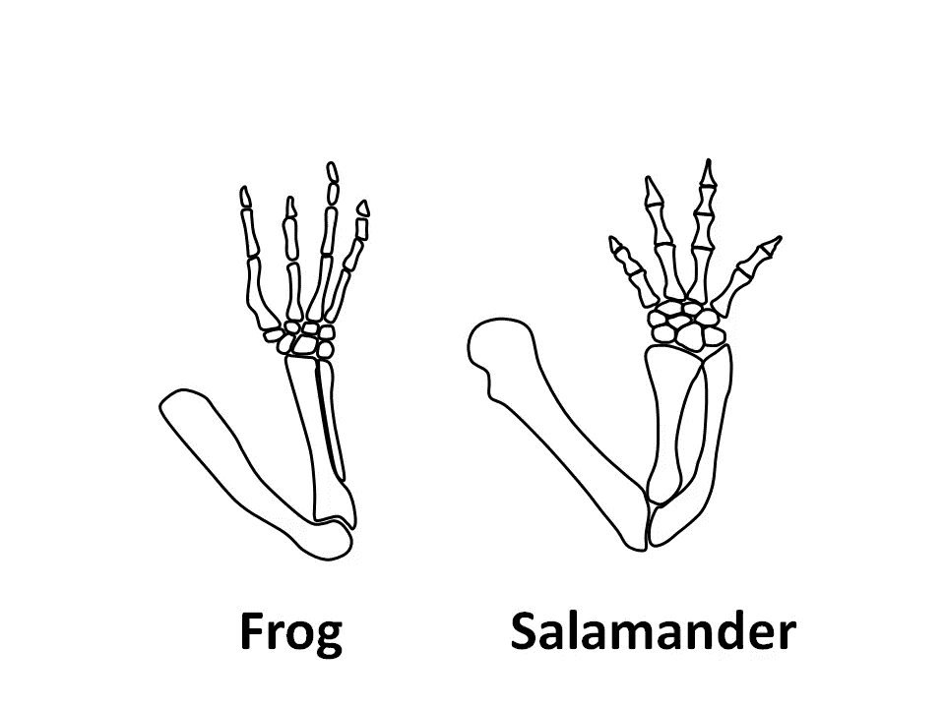
Homologous structures, or homology, are features that are similar across species.
However, these features have different functions or purposes, so it is unlikely they would have evolved independently.
The similarities wouldn't make sense unless they had been inherited from a common ancestor.

Slide 9
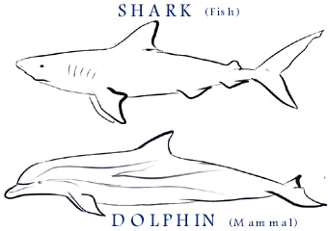
It's important to note that, even if structures may look similar, they are not all a result of homology.
Structures with similar functions, such as the fins of dolphins and sharks, evolved for the purpose of survival in a similar environment and not due to inheritance from a common ancestor. These are known as analagous structures.

Slide 10
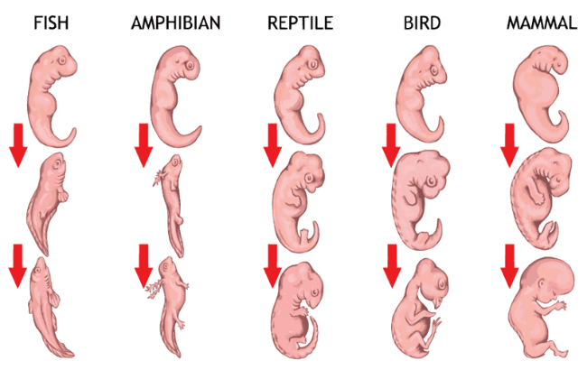
Embryology is the study of how creatures develop before being born, or before hatching from an egg.
Comparative embryology provides evidence for evolution because many embryos look very similar and have traits that do not necessarily persist as they grow.
For example, both human and fish embryos have gill slits. In fish, these develop into gills. In humans, they disappear before birth.

Slide 11
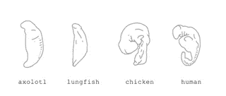
Gill slits are present in all vertebrate embryos, but do not develop into gills in any but fish.
This makes no sense unless the vertebrates inherited their gill slits from a common ancestor.
When different populations of the common ancestral species were subjected to different environments (e.g. land, instead of water), gills were no longer needed, so over time they ceased to develop.

Slide 12
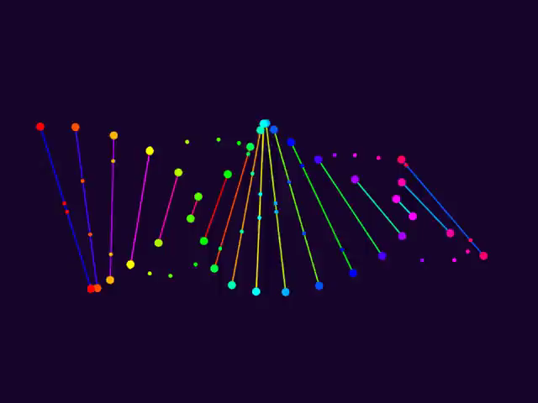
Similarities in different species' DNA sequences can provide evidence for evolution.
These similarities are investigated through DNA hybridisation and DNA sequence comparisons.

Slide 13
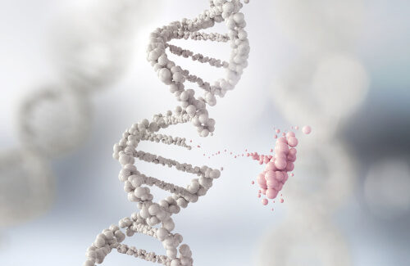
All organisms share the same genetic coding system, otherwise known as DNA.
Although DNA sequences differ between species, the sequences have some similarities that can be used to determine how closely related two species are.
Because mutations in DNA occur at a regular rate, biologists can compare the strands between species to predict how long ago they diverged from a common ancestor.

Slide 14
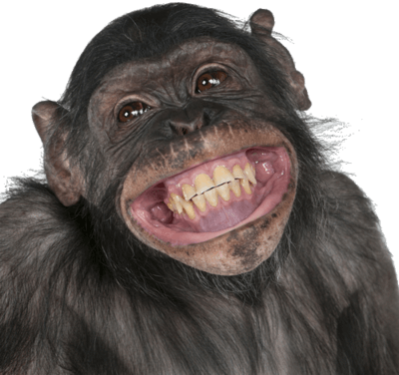
To illustrate how we can use DNA to investigate evolutionary relationships, let's look towards our closest relatives: the chimpanzees.
DNA comparisons have found that humans and chimpanzees are very closely related and share almost (99%) of the same DNA, despite their different appearance and behaviours.

Slide 15
The (99%) of DNA shared between chimpanzees and humans indicates that they are our closest relative, meaning that humans and chimpanzees diverged relatively recently, into different species.
This is in comparison to gorillas who, although closely related, share a lesser 98% of their DNA with humans.

Slide 16
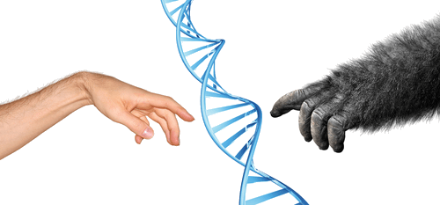
That humans are more genetically similar to chimpanzees indicates that we share a more recent common ancestor with them, compared to gorillas.
In other words, ancestral humans diverged from gorillas earlier than they did from chimpanzees. This allowed more time for humans and gorillas to accumulate changes between our respective DNA.

Slide 17
The more similar the DNA sequences of two species are, the more closely related the two species are.
A method of analysing for chemical similarities between DNA sequences is DNA hybridisation.
DNA hybridisation is helpful to see how long ago species could have diverged from a common ancestor by comparing the living species' DNA to that of the common ancestor.

Slide 18
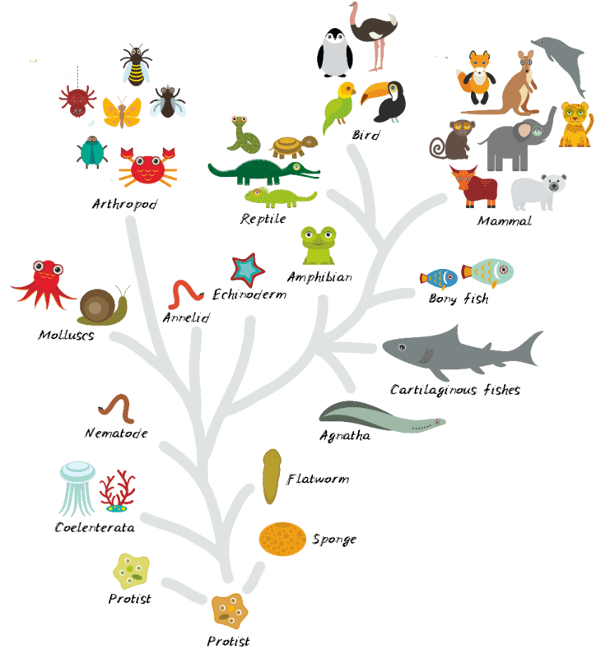

Slide 19
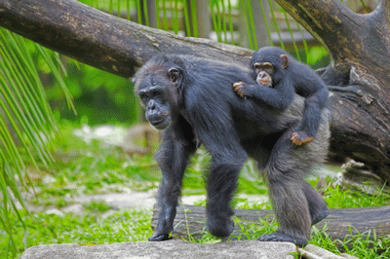
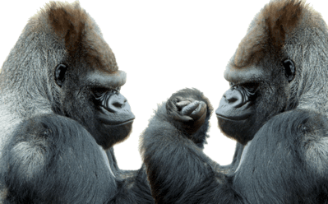
For example, humans and chimpanzees have more shared DNA than humans and gorillas do.
Because of this, hybrid human-gorilla DNA strands would separate at a lower temperature than the hybrid human-chimpanzee DNA strands would.

